Slide 1
Exploratory Data Analysis ON ONLINE Sales Data
Name : Sachin Varshney
Cohort : August 2020
Dataset Source : Kaggle

Slide 2

Introduction
Study is on Data Visualization for Online Sales Data.
Company Contains different types of segments - Consumer, Home office and Corporate.
Company is service provider of daily office needs .
Given Dataset also contains online sales data for different regions , market and countries.

Slide 3
Problem Statement & Scope
With the sales mentioned for online orders, we need to identify top 5 ordered product and revenue generating product.
Region wise , country wise and City wise sales distribution.
What is the average shipping time for ordered product?
What are the different and most frequent used shipping modes?
We need to identify profit distribution on the basis of regions and category.
Scope of Study:
Only 10292 odd products and 1590 customers are included in study.
The data is from 1st,Jan 2011 to 31st Dec 2014.
Regions in scope: Africa, Oceania, EMEA, North, Central Asia, West, North Asia, Central, South, Canada, East Southeast Asia and Caribbean.

Slide 4
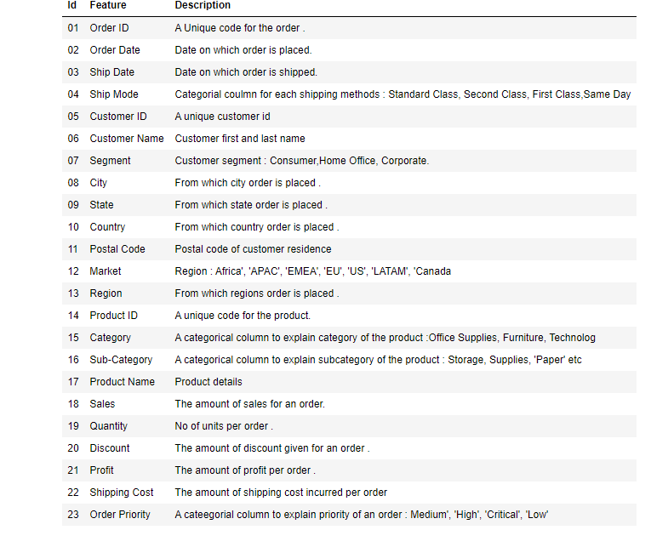
Data Description

Slide 5
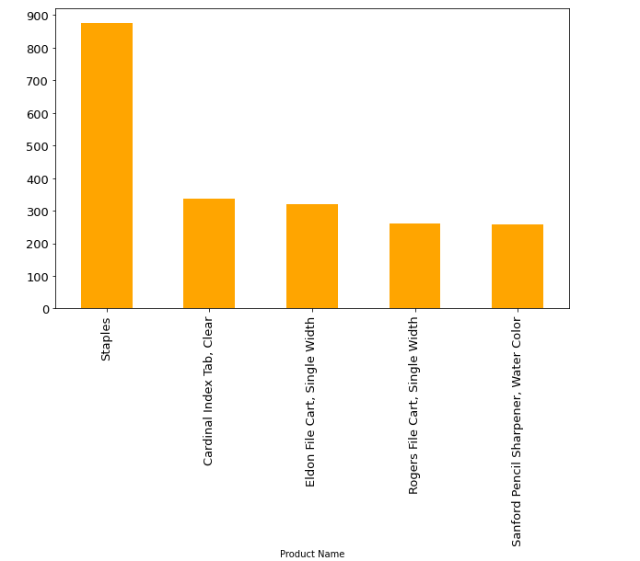
What are top 5 sold products?
Top 5 products sold products : Staples, Cardinal Index Tab, Eldon File Cart, Rogers File Cart, Sanford Pencil Sharpener.

Slide 6
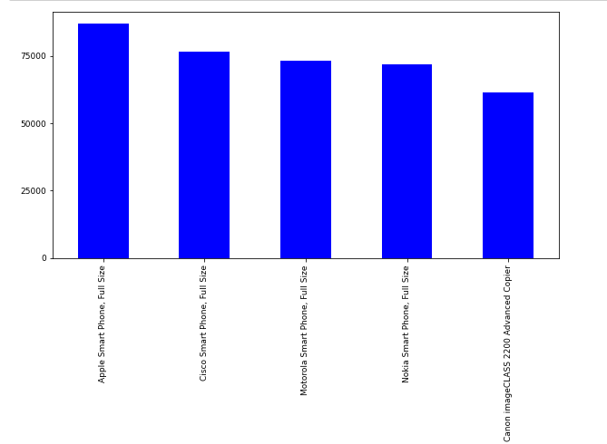
What are top 5 revenue generating products ?
Top 5 revenue generating products : Apple Smart Phone ,Cisco smart Phone, Motorola Smart Phone , Nokia Smart phone and Canon Image CLASS 2200 Advanced Copier.

Slide 7
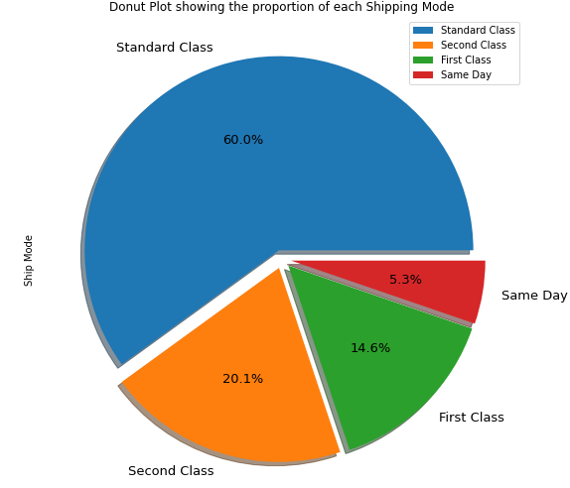
What are different shipping mode proportion?
About 60% of product sold are of Standard class shipping mode.

Slide 8
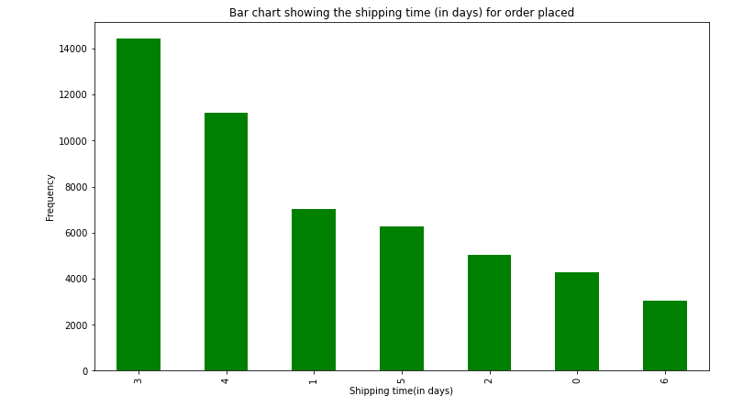
What is average shipping time for sold products?
Majority of order are shipped within 3 to 4 days and none of them are delivered after 7 days

Slide 9
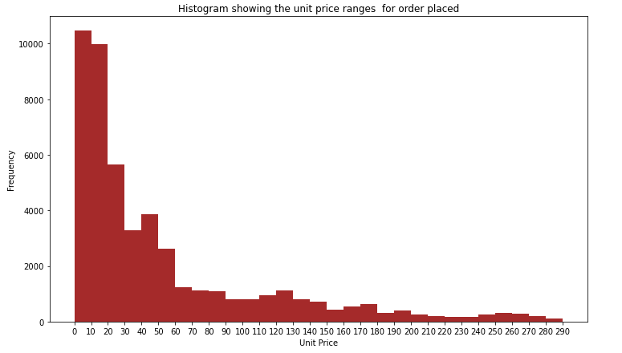
What is unit price ranges for order placed?
Majority of the products are in the range of 0-60 USD.

Slide 10
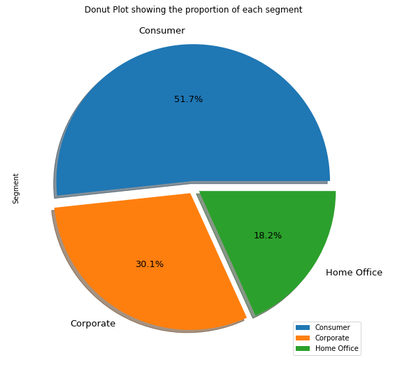
What are different segment type proportion?
About 51.7% of product sold are of consumer segment.

Slide 11
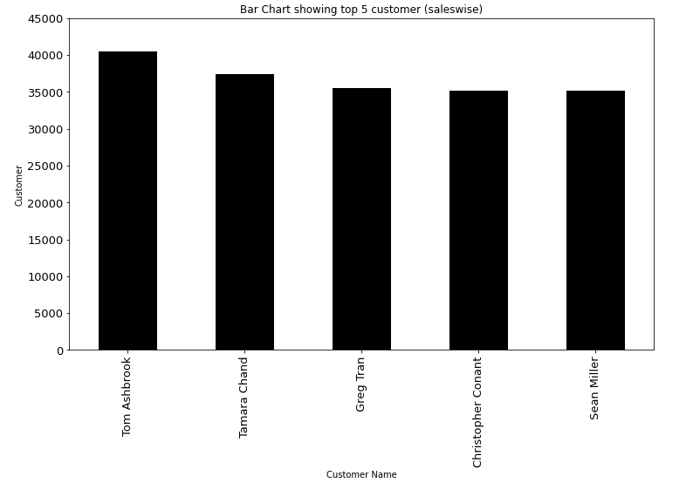
What are top 5 customer - sales wise?
Top 5 customer sales wise : Tom Ashbrook, Tamara Chand, Greg Tran, Christopher Conant and Sean Miller.

Slide 12
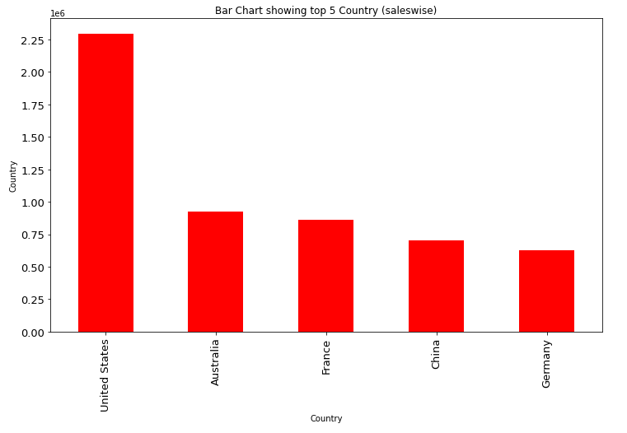
What are top 5 countries - sales wise?
Top 5 countries sales wise : United States, Australia, France , China and Germany

Slide 13
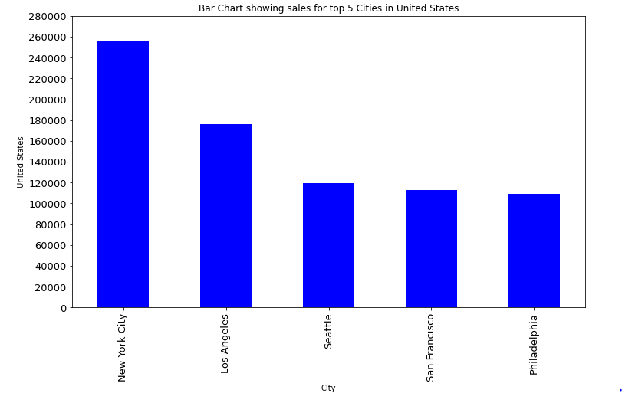
What are top 5 cities - sales wise?
Top 5 countries sales wise : New York City , Los Angeles, Seattle , San Francisco and Philadelphia.

Slide 14
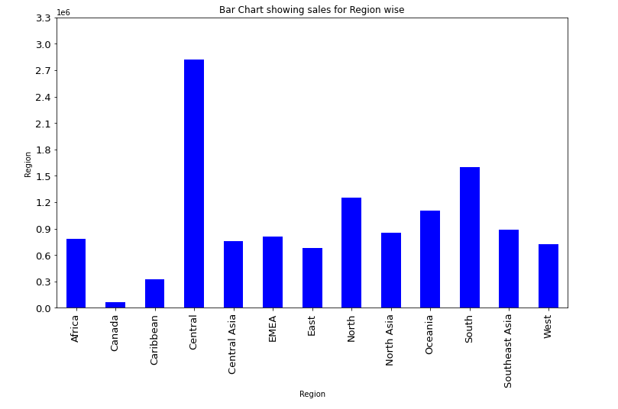
What region wise sales Trend?
Central region contribution is maximum towards sales.

Slide 15
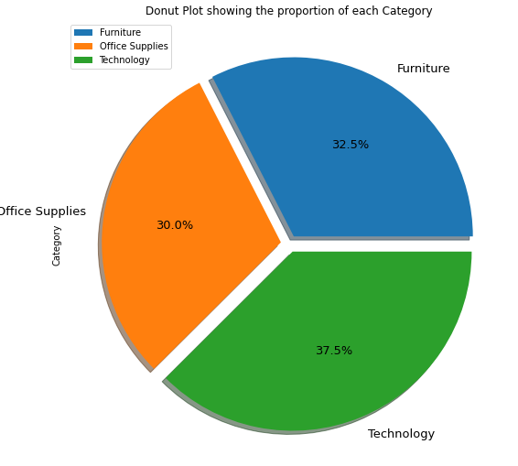
What is category wise sales distribution?
Technology category contributed is maximum towards sales.

Slide 16
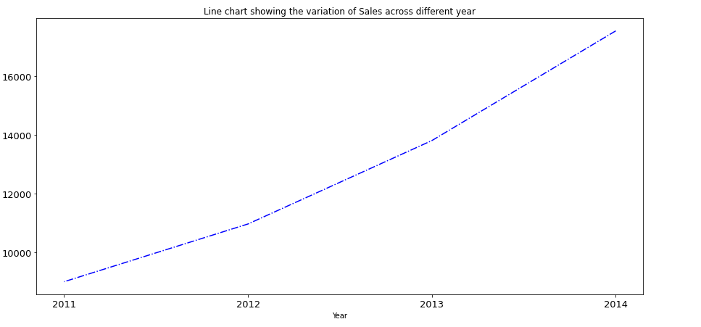
What is year wise sales trend ?
Sales is in upward trend with maximum sales in 2014..

Slide 17
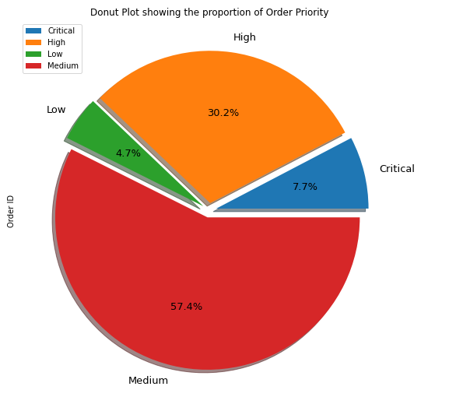
What is Order Priority distribution?
Maximum orders are of medium priority.

Slide 18
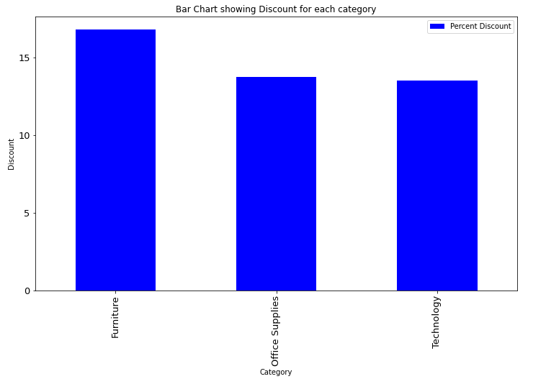
What is average discount offered in each Category?
Furniture offers maximum discounts.

Slide 19
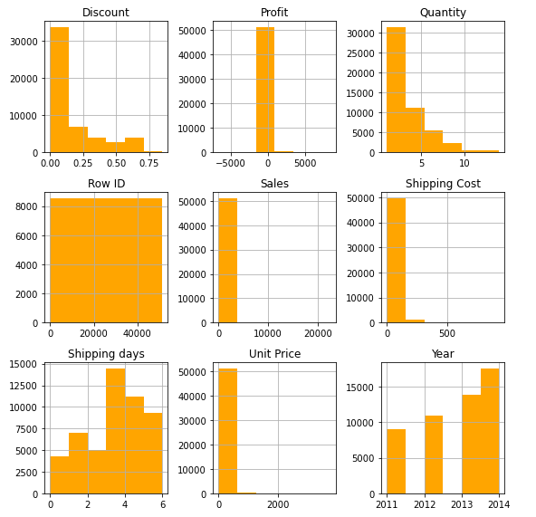
What is the range of each numeric field?
Most of the time discount ranges from 0-10%.
Majority of quantity lies from 0 to 5.
Max sales are in the range of 0 to 5000.
Max shipping cost are in the range 0 to 200.
Max shipping days range is from 0 to 6 days.
Majority of unit price range between 0 to 500
Order distribution is in upward trend with maximum ordered fulfilled in year 2014.

Slide 20
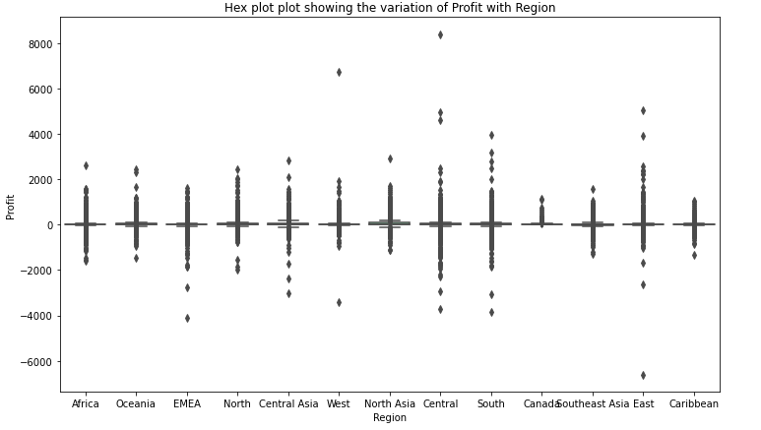
What is Region to Profit trend ?
Most profitable region is Central. On certain instances sales have exceeds more than 4000. Max loss making region is EMEA. There is no loss in Canada Region.

Slide 21
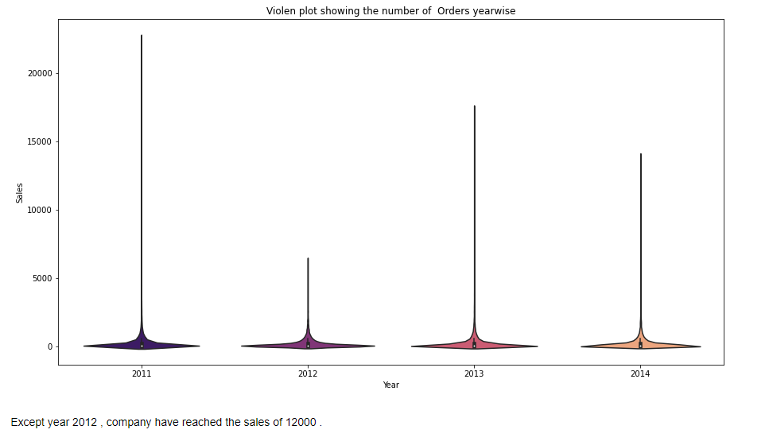
What is year wise order distribution?
Except year 2012 , company have reached the sales of 12000 .

Slide 22
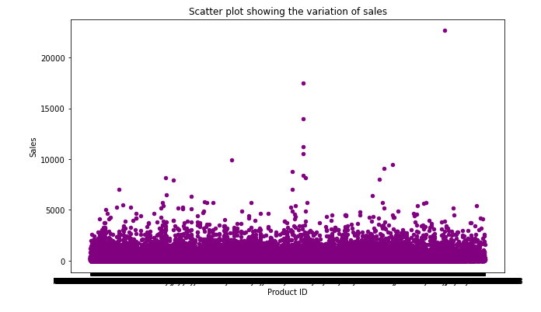
What is product to Sales distribution?
Maximum sales range is up to 5000 with few instances reaching sales of 20000.

Slide 23
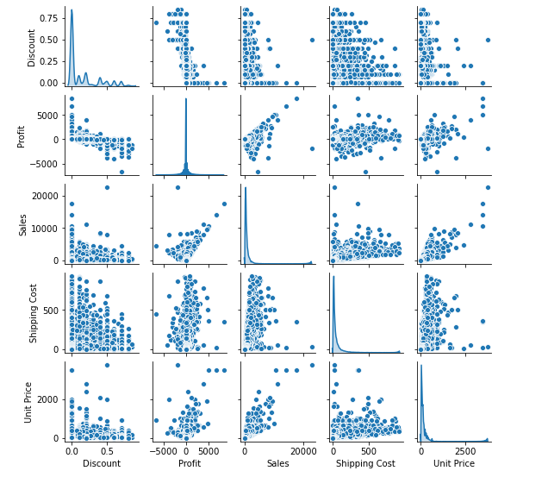
Pair Plot

Slide 24
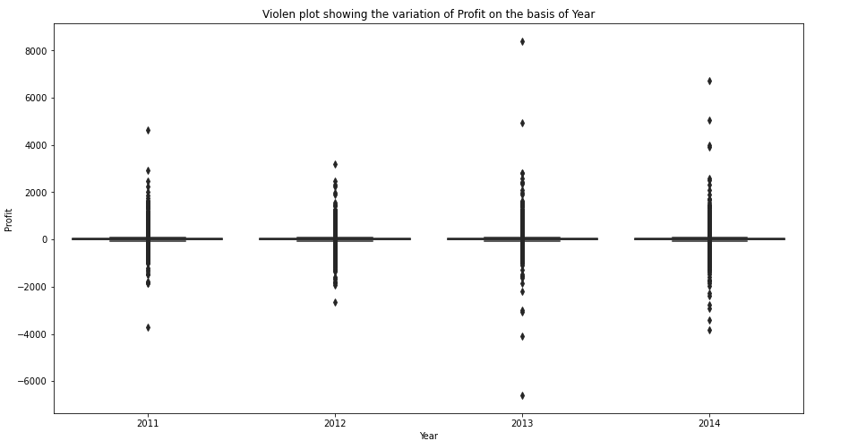
What is year wise profit distribution?
Maximum profit reached is above 8000 in year 2013. Maximum loss is around 6000 in year 2013.

Slide 25
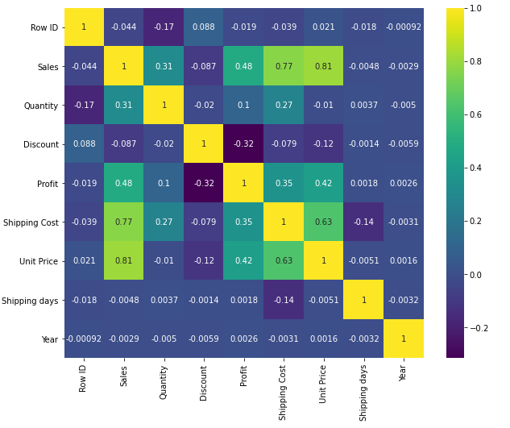
Which are correlated fields?
Unit price and sales are highly correlated. Shipping cost and sales are highly correlated.

Slide 26
Conclusions
Top 5 Item Types which are maximum sold: Staples, Cardinal Index Tab, Clear, Eldon File Cart-Single Width, Rogers file cart - Single width, Rogers File Cart-Single Width, Sanford Pencil Sharpener-Water Color.
Top 5 revenue generating products- Apple Smart Phone, Cisco Smart Phone, Motorola Smart Phone, Nokia Smart Phone, Canon image CLASS 2200 Advanced Copier.
Majority of order are shipped within 3 to 4 days and none of them are delivered after 7 days.
Majority of the products are in the price range of 0-60 USD.
Maximum product price ranges between 75 to 180.
Majority of products (60%) sold are shipping using Standard Class delivery mode.
Majority of products (51.7%) sold are of consumer Segment Type.
Top 5 customers providing sales are Tom Ashbrook, Tamara Chand, Greg Tran, Christopher Conant and Sean Mille.
United states have majority of contribution towards sales.
New York City contributes towards majority of contribution towards sales in US.

Slide 27
Conclusions-Continue
Sales is in upward trend with maximum sales in 2014.
Maximum orders sold are of medium priority .
Furniture is the category which offers maximum discounts.
Most profitable region is central region. On certain instances sales have exceeds more than 4000.
Max loss making region is EMEA .There is no loss in Canada Region.
Except year 2012 , company have reached the sales of 12000.
Maximum sales range is up to 5000 with few instances reaching sales of 20000.
Maximum profit reached is above 8000 in year 2013.Maximum loss is around 6000 in year 2013.
Unit price and sales are highly correlated.
Shipping cost and sales are highly correlated.
Central region contribution is maximum towards sales.
Technology category contributed is maximum towards sales.(37.5%).

Slide 28
Actionable Insights
Company need to identify the reasons why sales are less in Canada .
Company need to identify why EMEA region is max loss making region.

Slide 29


